Slide 1
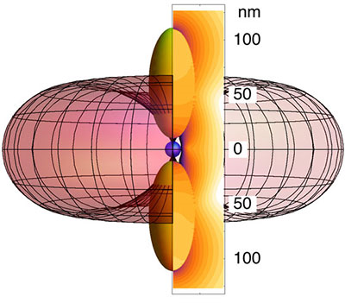
Quantum Technologies
Women in Quantum Technologies: what are the challenges?
Ruth Oulton – gender balance advisor for COST Action MP1403 Nanoscale Quantum Optics

Slide 2
Why is Quantum Information Science Important Now?
Future and Emerging Technologies “Quantum Technology Flagship”

Slide 3
What effect with the Quantum Technologies Flagship have on numbers of female scientists?
1B€ for Quantum Technologies over 5 years in Europe
This will fund several hundreds of research scientists – a significant number for Europe!
If only 10% are women, what effect will this have on the numbers of female scientists in Europe?
Can we use the QT Flagship as an opportunity for change?

Slide 4
Exploring gender balance in a COST Action
How much do scientists themselves know about these issues? To answer we did two things:
Ran a survey of attitudes towards gender equality in science
Ran discussion sessions with the whole COST NQO community at our meetings. Topics (usually thought-provoking and controversial) include: parenthood and academia, sexual harassment, affirmative action/positive discrimination…
Ran a second survey to see whether opinions and actions had changed

Slide 5
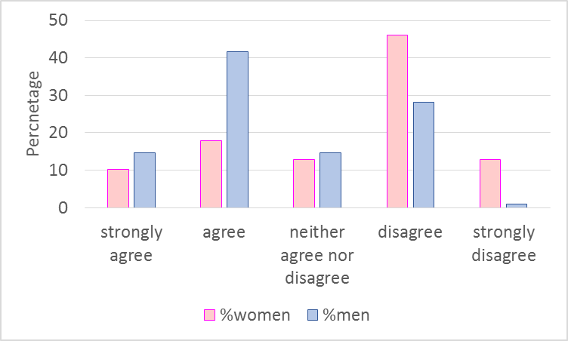

Survey of quantum scientists 1
QUESTION 1: Women and men in my field have equal opportunities for career advancement
QUESTION 3: IN MY WIDER NETWORK (EG CONFERENCES, PROJECT MEETINGS ETC) MEN AND WOMEN ARE TREATED EQUALLY REGARDLESS OF GENDER
There is a clear imbalance between mens’ and womens’ views.
64% of women believe that they do not have equal opportunities to men.
However, 56% of men believe there is no difference in opportunities.
69% of women disagreed that women are treated equally in their wider network.
ALL nine female post docs disagreed with this statement. 33% of them strongly disagreed.

Slide 6
The effects of implicit bias
[1]Moss-Racusin et al. “Science faculty’s subtle gender biases favor male students” PNAS 109 16474 (2012)
Women had to have 3 Science papers more than men to be considered for fellowship in Sweden [2]
A CV from student “Jennifer” was assessed more negatively than an identical one from student “John” [1]
Women with impact score >99 assessed as being on a par with men with impact score 20. Difference = 3 Science papers.
“blind” metric based on citations
[1]Moss-Racusin et al. “Science faculty’s subtle gender biases favor male students” PNAS 109 16474 (2012)
“subjective” peer review score
[2] Wenneras and Wold, “Nepotism and sexism in peer review” Nature 387, 341 (1997)

Slide 7
The effects of implicit bias
There are many, many studies that demonstrate implicit bias against women, either in academic science or more generally in the work-place
Compared to men, women with equal attributes are:
Less likely to have their journal papers accepted if either first or last author
Less likely to be cited
Less likely to be invited to present their research at conferences
Less likely to be hired and will be paid less
Receive fewer glowing reference letters
Less likely to receive research funding
The effects of implicit bias – unconscious stereotyping are difficult to counteract!

Slide 8
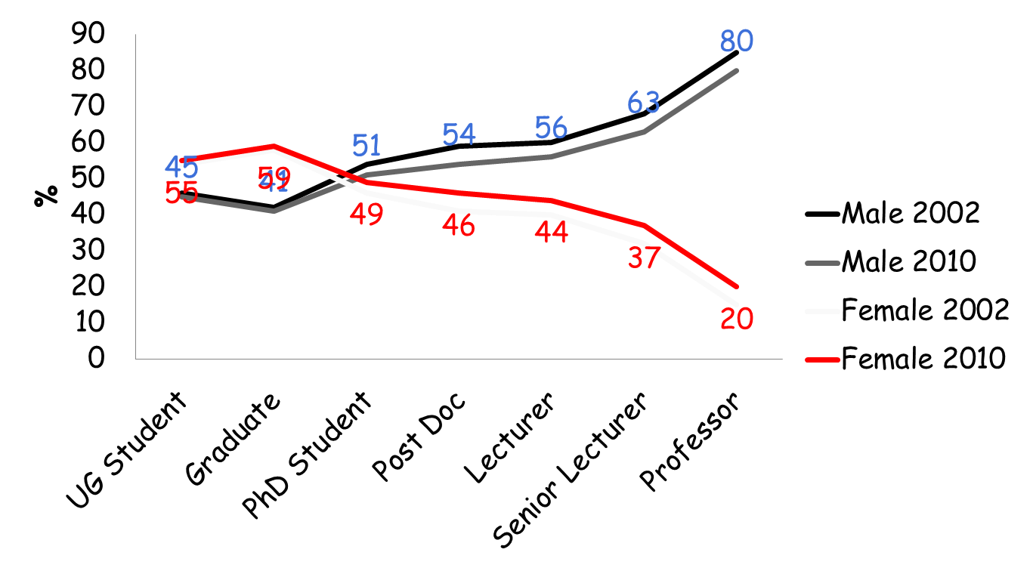
The results of implicit bias
Numbers of men/women in all “STEM” subjects
[3] “Women in the workplace in 2016”, McKinsey and Company
Equality Challenge Unit: Equality in higher education: statistical report 2013
Female numbers are low across a wide range of technical subjects in the industrial and academic sector, getting worse with seniority.

Slide 9
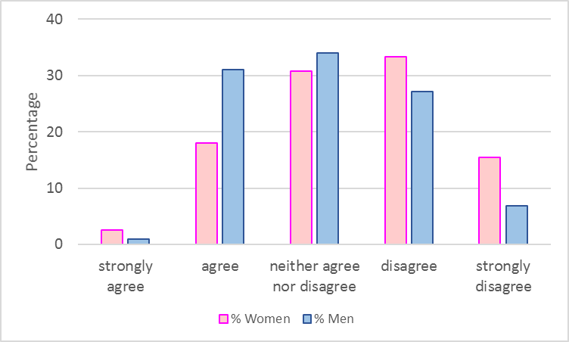
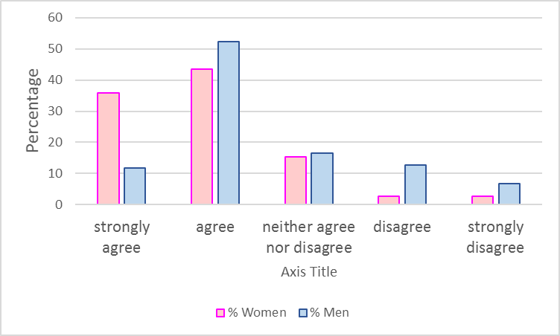

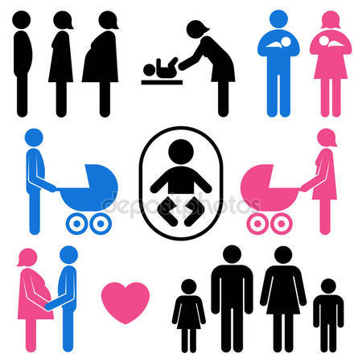
Survey: parenthood
  Question 4: Women in my field with young families or caring responsibilities are disadvantaged in their career.
Question 5: Men in my field with young families or caring responsibilities are disadvantaged in their career.
There was a broad agreement (67%) that mothers and other female carers experience disadvantages in their career.
Women highlighted this as a particular disadvantage, with 44% agreeing and 36% strongly agreeing that this is an issue.
Male opinions about male carers was more divided. 34% of male respondents did not feel there was a disadvantage but 32% felt that there was a disadvantage.

Slide 10
Survey 2019: Early Career Fathers
Question 5: Men in my field with young families or caring responsibilities are disadvantaged in their career.
Almost half of early career men feel fathers are at a disadvantage, 40% of senior men agree
Two thirds of senior women do not think that fathers are at a disadvantage.

Slide 11




Parenthood and academia: a Spanish study
A man with children is 4 times more likely to be promoted to Full Professor than a women with children….
From the same study ,around 69% of female professors have no children, while 63% of male professors have children.
…but a man with children is also 1.7 times more likely to be promoted to Full Professor than a man without children.
Men with children are the most successful academics, women with children are the least successful [4]
[4] Spanish Gov. White Paper on Women in Academia

Slide 12
Getting a Job: Is There a Motherhood Penalty?
Study on attitudes towards mothers and fathers in the workplace
Fictitious CVs that indicated whether applicant was a parent or non-parent were given to employers for assessment.
“Mothers were allowed significantly fewer times of being late to work, and they needed a significantly higher score on the management exam than nonmothers before being considered hireable.”
“Fathers were rated significantly more committed to their job than non fathers. Fathers were allowed to be late to work significantly more times than non fathers.”
Shelley J. Correll et al. American Journal of Sociology (2007)

Slide 13
Survey: Parents on their own careers
56% of mothers 31% of fathers say that caring responsibilities have had a positive impact
However, 38% of mothers and 36% of fathers say that caring responsibilities have had a negative impact

Slide 14
Survey: Experiences of Sexual Harassment
QUESTION 11: I have, or know someone who has, experienced sexual harassment by a peer and/or superior
Almost half of all women (48%) report some experience of sexual harassment.
Sexual harassment is an almost universal experience (83%) by the time women become senior.
The experiences of the most senior academics was hugely divided on gender grounds.
  53% of women said that they knew of several people affected
  70% of senior men did not know of it happening to anyone. Only 20% of men knew of several people affected.

Slide 15
Survey: actions against sexual harassment
Question 10: I am familiar with my institution's sexual harassment policies and would be confident of what to do if approached by a junior colleague with a complaint.
Even half of senior women would not know what to do to support a junior colleague

Slide 16
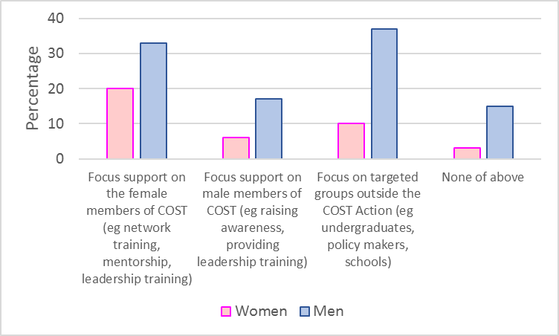
Survey: What activities are most effective?
  Question 9: If we were to focus effort on one activity to improve gender equality in this COST action it would be:
Most respondents felt that more focus should be on women rather than men. 51% of women and 32% of men felt that this would be the most useful.
The least popular option was to focus on men. Only 15% of women and 17% of men felt that this would be most useful.

Slide 17
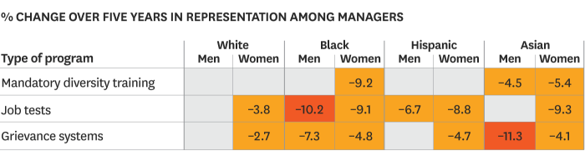
When interventions go wrong
The backlash effect:
Hiring/promotion of women and ethnic minorities decreased when the following interventions were used:
Mandatory diversity training was often signalled as remedial (the employee has a problem that needs fixing), and conveyed negative messages (the legal implications, not the positive effects for the company).
Hiring tests to assess competence are often not applied to everyone (people known to the hiring committee are not tested) and results are interpreted inconsistently, with bias against the unknown party.
Grievance procedures are often not carried through correctly, result in retaliation, and employees who lose faith in system.

Slide 18
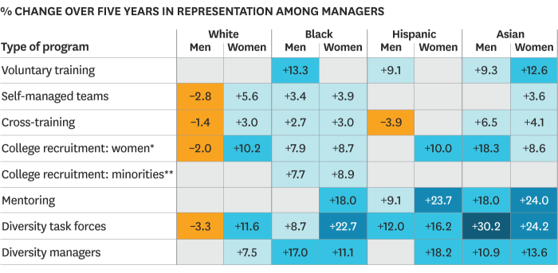
Doing it right
Voluntary diversity training empowers employees instead of being part of the problem.
Mentoring of minorities chips away at senior managers’ biases. Note that mentoring can be open to all but is often taken up more by minorities.
External diversity task forces who monitor diversity increase social accountability:
Task forces allow identification and elimination of specific roadblocks for the minority.
F. Dobbin and A. Kalev “Why Diversity Programs Fail” https://hbr.org/2016/07/why-diversity-programs-fail (2016), American Sociological Review 71 (4):589-617.

Slide 19
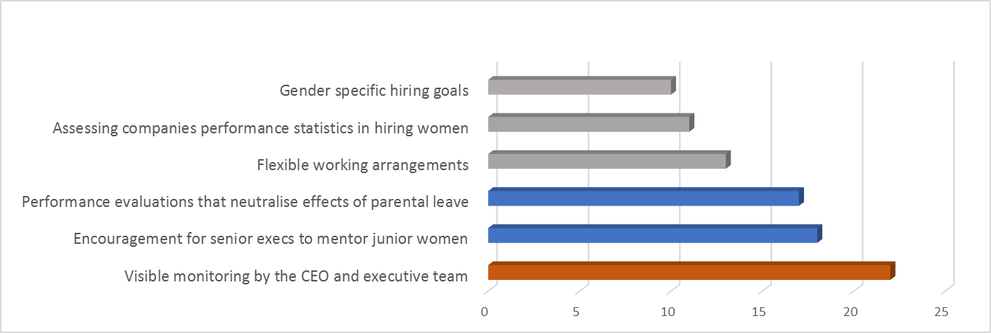
What interventions work?
Active support by CEOs and senior executives are in top most effective gender interventions [7]

Slide 20
What Next?
The survey showed two important things:
Male and female scientists do not agree about the importance and causes of gender imbalance
Most scientists are not aware of the existing research on the subject.
Our approach:
  Arm scientists with factual knowledge – we gave information about implicit bias and other studies during scientific meetings
  Encourage active engagement via discussion sessions: with an equal voice for men and women.

Slide 21


Discussions with equal voice
Step 1: Separate confidential discussions amongst women and men only groups
Step 2: Representative from each group gives overview of discussion
Step 3: Further discussion together

Slide 22
Previous discussions on sexual harassment
We started discussions about sexual harassment during COST meeting in Marseille.
Main conclusions:
  ALL women has experienced intrusive comments about their body or unwanted sexual touching during their career, mostly when junior
  Women reported how traumatic this was at an early stage in their career
  Men were mainly unaware of how common this was.
  BUT men are also vulnerable to false accusations of harassment
  All agreed that clearer guidelines and a clear action from those in authority was most important.
  Those in authority must be SEEN to taken swift and fair action.

Slide 23
Previous discussions on affirmative action/quotas
Discussions about affirmative action or positive discrimination for women
Main conclusions:
  Sharp divide between men and women on this issue
  Senior women believe that quotas are the only way to achieve equality
  Men had more mixed opinions:
    some felt that some affirmative action (such as making sure women reach the interview panel) would be a good idea
    Others reported that similar affirmative action had had negative effects

Slide 24
Did we change opinions and actions?
QUESTION 13: I PERSONALLY UNDERTAKE ACTIVITIES TO SUPPORT GENDER EQUALITY (EG MENTORING, RAISING AWARENESS, GENDER SPECIFIC OUTREACH)
Many more men (60%) reported personally undertaking activities in 2019, compared to 33% in 2016
Women reported a slightly increased level of engagement in 2019 (78%) as in 2016 (64%).

Slide 25
Conclusions: and What Next?
Information, information, information!
  Larger survey numbers needed
  Need information on female funding levels and participation levels, for example in Quantum Flagship
Inform, discuss, encourage
  Scientists need facts and data to be convinced!
  Keep on asking women for their perspectives
  Allow an opportunity for free discussion on controversial topics
  Enable senior scientists and leaders to lead the way
  Ensure funders policies are female friendly

